Slide 1

Full Custom Design in VLSI
A seminar paper presentation by Emirkan Sali

Slide 2

Introduction
Integrated Circuits used in almost every electronic device
Moores law increases chip complexity
Very Large Scale Integration (VLSI) technology for chips
Semi-Custom design mostly used to save time and costs
Full-custom design in VLSI provides full control and performance benefits

Slide 3

VLSI
VLSI refers to design process of creating circuits with lots of transistors
VLSI typically means 10.000 – 100.000 transistors, but is also used for more
Using HDL to synthesize digital circuits.
Design steps include complexity determination and calculations for objectives

Slide 4

Semi Custom and Full Custom
Designing IC‘s two design approaches used: Semi Custom and full custom
Semi custom approach saves time and costs by using standard cell libraries and reusing bought or older components
Full custom design aims to create the entire system from the start to end.
Design team has control over every component and transistor and can route efficiently.
Full custom design typically provides higher performance and effiency at the cost of development time

Slide 5
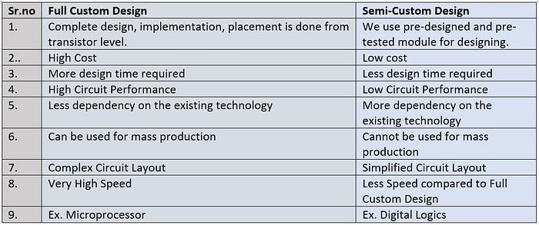

Slide 6
Semi Custom Design Approach
Standard Cell approach
Gate Array Design
FPGAs

Slide 7
Full Custom Design Approach
Architectural Design: specification of required functionality and objectives
Logic/ Circuit Design: interconnecting macro level building blocks to implement functionality
Physical Design: layouting and floorplan
Physical Verification: modeling of physical effects and design rules checking

Slide 8

Challenges
More complex systems due to Moores law
3D-IC designs pose more challenges
Proper usage of AI assistance tools

Slide 9

Application Areas
High-performance processors
ASICs
GPUs
Some microprocessors
Precision timing circuits

Slide 10
Future trends
AI assistance in electronic design automation (EDA)
Apaptive AI enhances exisiting EDA processes to cut down on manual labor
Additive AI learning over time to save engineers from repetitive work
Assistive AI to pinpoint weak points in a chips design

Slide 11
Conclusion
Full Custom design is the standard process if semi custom design is not sufficient
Design approach includes complicated steps and requires a competent team and alot of time
Challenges are tied to the typical challenges of ICs (Moores law, 3D designs, AI)
Vast area of applications, especially for critical and high performance systems
Future could be defined by recent breakthrough in AI technology, providing assistance for tasks and lowering development time and costs

Slide 12
User References
[1] T. Dillinger and a. O. M. C. Safari, VLSI Design Methodology Development, First Edition. Prentice Hall, 2019.
[2] Radha Kulkarni. Full-Custom and Semi-Custom VLSI Designs: Pros, Cons, and Differences. [Online]. Available: here
[3] James Morra. AI Lends a Helping Hand with Analog and Custom IC Design. [Online]. Available: here
[4] D. A. P. Reddy. (2019) Vlsi design. Acessed: 20th of December, 2023. [Online]. Available: here

